Slide 2
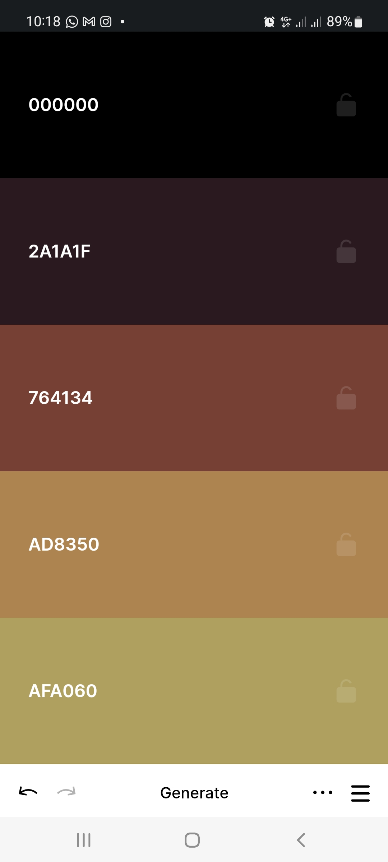
Colour code
#afa060
#ad8350
#764134
#2a1a1f
#000000

